Slide 1

DF
LECTURE
Evidence Extraction
& Analysis
Diploma in CSF/IT
Year 2/3 (2022/2023), Semester 4/6
Digital Forensics
3
Notes:
Left-hand Bar – Replace FSP by your module code and X by the lecture number.
Replace Lecture Title
Replace < Module Name >
Replace Year and Semester if necessary

Slide 2
Objectives
At the end of this, you will get to know more about:
Slack, Allocated and Unallocated Space
Types of evidence extraction
Common analysis methods
How to collect evidence from live Windows operating system
How to interpret event logs

Slide 3
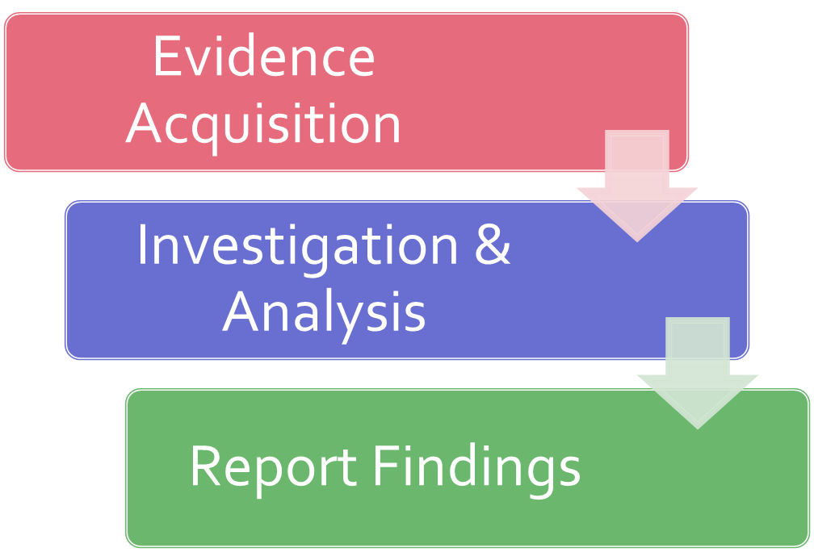
Recall: Forensics in a Nutshell

Slide 4
Refresh (Optional)
Let’s try to understand a little more about how data are stored in hard disk before going into the different extraction and analysis methods.

Slide 5
Hard Disk Drive (Optional)
Main storage media for most computer systems.
Holds the
Boot files
Operating system files
Programs files and
Data files

Slide 6
Hard Disk Drive – cont. (Optional)
Tracks are the thin concentric circular strips on a disk or platter surface which comprise the magnetic medium to which data is written by the drive heads.
A cylinder comprises the same track number on each platter, spanning all such tracks across each platter surface that is able to store data.
Data is written to and read from the surface of a platter by a device called a head.
Tracks are divided into sectors.
A sector is the smallest physical storage unit on a disk →512 bytes in size.

Slide 7
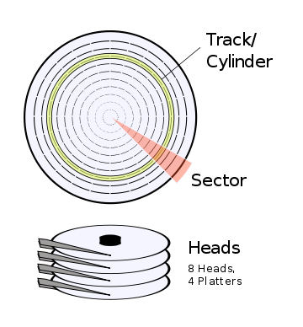
Hard Disk Drive – cont. (Optional)
Notes:
However, Windows has limited the filenames to 240 chars.

Slide 8
How data is stored on disk? (Optional)
Data is stored on a disk in a contiguous series.
For example if a file is 600 bytes, two 512 sectors are allocated for the file.
Note :
Cluster - Smallest unit of storage that the operating system can deal with.
- A cluster may consists of several sectors.

Slide 9
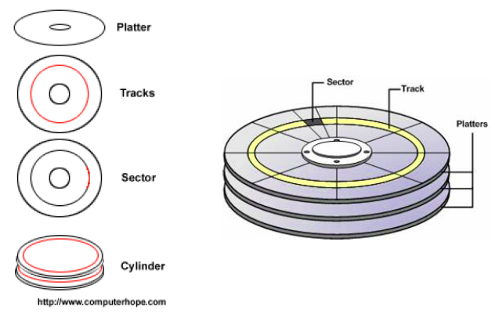
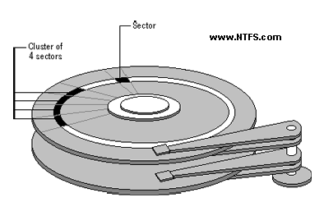
A Cluster of 4 Sectors (Optional)

Slide 10
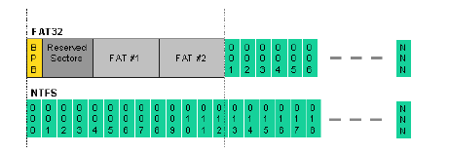
Clusters (Optional)
Smallest allocation unit of a hard disk.
A relevant formatting scheme determines range of tracks and sectors from 2 to 32.
Minimum size can be of 1 sector (1 sector/cluster).
An allocation unit can be made of 2 or more sectors (2 sectors/cluster).
Any read or write operation consumes space of at least 1 cluster.
A lot of slack space or unused space is wasted in the cluster beyond the data size in the sector.

Slide 11
Slack Space
It is the unused space between the end of the actual file and the end of the defined data unit (cluster).
When a file is written, and does not occupy the entire cluster, the remaining space is slack space.

Slide 12
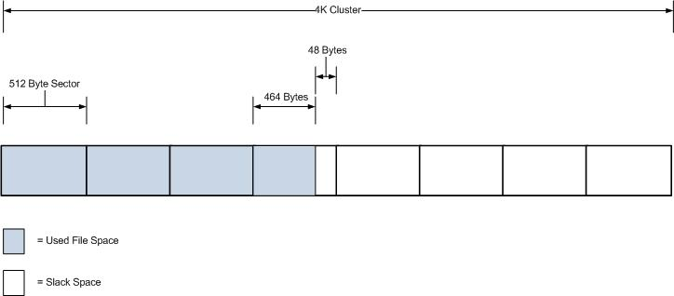
Slack Space – cont.
For example, assume that the OS uses a 4k cluster and 512 byte sector. This means that if a 2000 byte file were written to this cluster the remaining 2096 bytes would be slack.

Slide 13
Slack Space – cont.
Within this slack space (so called file slack) there are two areas to consider –
the first is that between the end of the actual file and the sector in which the file ends
This sometimes referred to as RAM slack, is padded with data as determined by the OS.

Slide 14
Slack Space – cont.
the second is the remaining sectors in the cluster that contain no data.
It is also OS dependent but can either be untouched or wiped.
In cases where the OS does not wipe the unused sectors, there will be remnants of the previous file that existed. An analysis of the slack space in this case could expose sensitive information.

Slide 15
Activity 1
A computer is configured with cluster size of 4 sectors. If a file of 5,000 bytes is written onto the disk, what is the slack space created? Show your working and answer in bytes.
1 sector size = 512 MB
Cluster size of 4 sectors = 4 * 512 MB = 2048 MB
Number of clusters req. – 5000/ 2048 (rounded up) = 3
Total space given by OS to store file = 2048 * 3 = 6144MB
Slack space = 6144 – 5000 = 1144 MB (Answer)
5000 – 4096 = 904
904 – 512 = 392
512 – 392 = 120
RAM Slack = 120. Remaining Slack = 512. + 512 = 1024

Slide 16
Unallocated & Allocated Space
Unallocated space
The area or space on the hard drive of the computer that is available to write data to.
Not viewable to the typical computer user and requires specialized computer forensic software to view and analyze.
It can contain deleted files or partially deleted files. When a file is deleted, the pointers to the file are removed, but the data remains in unallocated space until such time as the operating system stores another file in the same space, thereby over-writing the data.

Slide 17
Unallocated & Allocated Space
Allocated or Active space
The area or space on the hard drive the contains the operating system and user data (files) that are easily accessible to the computer user.

Slide 18
Unallocated & Slack Space
File slack is technically allocated space, however, it typically contains data that are part of the previous file or some random contents of memory, or both.
The tools and procedures to find evidence should include unallocated and slack space.

Slide 19
Activity 2
Why are slack space and unallocated space the important areas to be included in any investigation?
Because there could be data that is stored in them still. Deletion of a file only removes the pointer to the file, but the remnants of the file still remains until it is overwritten by the OS when new data is allocated to the same location. And slack space could still contain data from deleted files. This can help in the investigation

Slide 20
Evidence Examination
The purpose of the examination process is to extract and analyze digital evidence.
Before evidence examination, FI should generate a hash of the image copy of original media. The 2 hashes should agree before examination can proceed.
Examination should be carried out on image copy to avoid tampering the original evidence.
Extraction refers to the recovery of data from its media. Analysis refers to the interpretation of the recovered data and putting it in a logical and useful format.

Slide 21
Evidence Examination – Extraction
Types of extraction:
Manual inspection
File Signatures
Timestamp and other metadata
String and Keyword searching
File carving

Slide 22
Manual Inspection
If the size of data to review is small, it may be faster than wasting time trying to “figure out a better way”.
It also provides increased confidence in your results.
Commonly used to validate the results.

Slide 23
File Signatures
Attackers sometimes rename files to disguise them as another file types.
Microsoft Windows names temporary files with extension .TMP even though they may be Word or Excel documents when a user opened from email attachment.
Hence just examining file extensions is a risky way to perform forensic analysis as you may miss important relevant evidence.

Slide 24
Timestamp and other Metadata
Metadata includes full filenames, file sizes, MAC times, MD5 hashes, etc.
Searching can be based on last accessed or modified time.
Can search for known files by comparing MD5 and SHA-1 hash of file’s content with a hash database.

Slide 25
String or Keyword Searching
String or keyword searching is one of the most basic extraction methods.
FI creates a list of keywords (strings) that are used to search evidence files.
Common techniques:
Based on file names and patterns in the file names.
Based on a keyword in their content
However, certain conditions such as encoding or formatting can render a string search useless.
Hence it is imperative that the FI understand how the string they are searching for is represented in the data they are searching.

Slide 26
File Carving
This technique combines aspects of several methods.
The idea is to search for a unique sequence of bytes that corresponds with the header, or the first few bytes of a file.
Most common file formats have standardized header that marks the beginning of a file, and sometimes a footer that marks the end of the file.

Slide 27
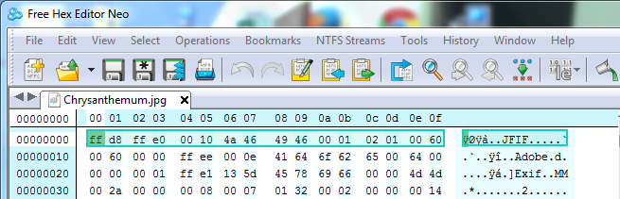
File Carving – cont.
A sample header for a JPEG graphics file:

Slide 28
Analysis of Extracted Data
Try to understand what the suspect was trying to do with the computer.
Common analysis methods used to solve the case:
Timeframe
Data hiding
Application and file

Slide 29
Timeframe Analysis
Useful in determining when events occurred on a computer system.
Can be used as a part of associating usage of the computer to an individual(s) at the time the event occurred.
Two methods:
Reviewing time stamps and date stamps that are found in the file system metadata. E.g last modified, last accessed, created, change of status.
Reviewing event logs

Slide 30
Data Hiding Analysis
Data can be concealed on a computer system.
Data hiding analysis can be useful in detecting and recovering such data and may indicate knowledge, ownership or intent
Can be performed in the following ways:
Identify mismatches of the file headers against the file extensions – presence of a mismatch indicates a malicious intent to conceal data.
Access all password-protected, encrypted, and compressed files – indicating that the illegitimate user has or tried to conceal the data from unauthorized users.
Steganography

Slide 31
Application and File Analysis
Inference from the files identified provide details such as the proficiency of the user.
We can infer the followings to identify details:
Reviewing file names for relevance and patterns
Examining file content
Co-relating the files to the applications installed on the target computer
Looking for similarities between the files. E.g. co-relating Internet history to cache files and e-mail files to e-mail attachments

Slide 32
Collecting Evidence from Operating System
Beside examining on the image copy of a computer hard drive, the following evidence may also be obtained from a live system during an investigation:
Web browsers
Chat logs
Event Logs

Slide 33
Finding Evidence in Web Browser
Browser may contain indirect evidence of specific crimes.
E.g. If a person is suspected of having cracked a password to hack into a server and steal financial data, indirect evidence may be found in his browser.
Check browser history.
E.g. Internet Explorer browser history

Slide 34
Finding Evidence in Web Browser
Location of Google Chrome history
Windows
C:\Users\<username>\AppData\Local\Google\Chrome\User Data\Default C:\Users\<username>\AppData\Local\Google\Chrome\User Data\Default\Cache
macOS
/Users/<username>/Library/Application Support/Google/Chrome/Default /Users/<username>/Library/Caches/Google/Chrome/Default/Cache
Linux
/home/<username>/.config/google-chrome/Default /home/<username>/.cache/google-chrome/Default/Cache
https://www.foxtonforensics.com/browser-history-examiner/chrome-history-location

Slide 35
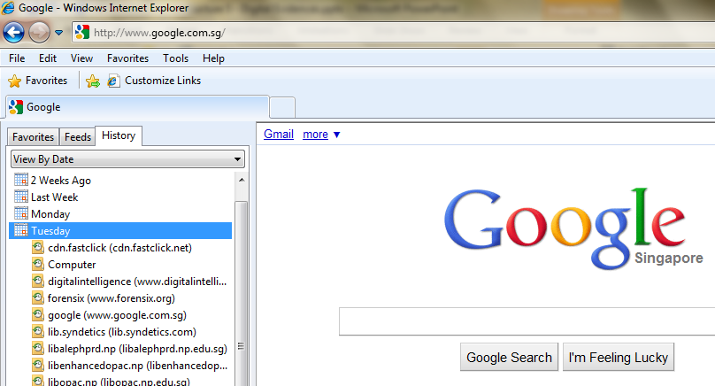
Internet Explorer Browser History

Slide 36
Finding Evidence in Chat Logs
Criminal activities could be facilitated via chat-room discussions.
Most chat software (MSN Messenger, Yahoo! Messenger etc.) keeps temporary log of conversations.
E.g. For MSN Messenger, the default location is C:\Users\<user>\Documents\My Received Files\

Slide 37
Event Logs
Event logs are generated by system-wide auditing and monitoring mechanisms that are built in to Windows OS.
By reviewing the logs, we may be able to perform the following:
Identify successful and failed logon attempts and determine their origin
Track the creation, start, and stop of system services
Track usage of specific applications
Track alterations to the audit policy
Track changes to user permissions
Monitor events generated by installed applications (such as antivirus, database etc.)

Slide 38
Event Logs – cont.
All versions of Windows maintain three core event logs: Application, System, and Security.
Activities related to user programs and commercial off-the-shelf applications populate the Application log.
Application events that are audited by Windows include any errors or information that an application wants to report.
Host-based security tools such as antivirus and Intrusion prevention systems often record events to this log.

Slide 39
Event Logs – cont.
Windows authentication and security processes record events in the Security log.
This log can include user logon and logoff attempts, account creation, changes to user privileges or credentials, changes to audit policy, process execution, and file and directory access.
Local or Group Policy settings can configure exactly which security events are captured and logged.

Slide 40
Event Logs – cont.
The System event logs events reported by a variety of core OS components.
Its contents can include Windows service events, changes to system time, driver loads and unloads, and network configuration issues.

Slide 41
Event Logs – cont.
Acquiring Windows event logs is a straightforward file acquisition task.
Each log is stored in a separate file in paths specified within registry key HKEY_LOCAL_MACHINE\SYSTEM\CurrentControlSet\Services\Eventlog.
On Windows 7, the default paths are:
Application:
%SYSTEMROOT%\System32\Winevt\Logs\Application.evtx
System:
%SYSTEMROOT%\System32\Winevt\Logs\System.evtx

Slide 42
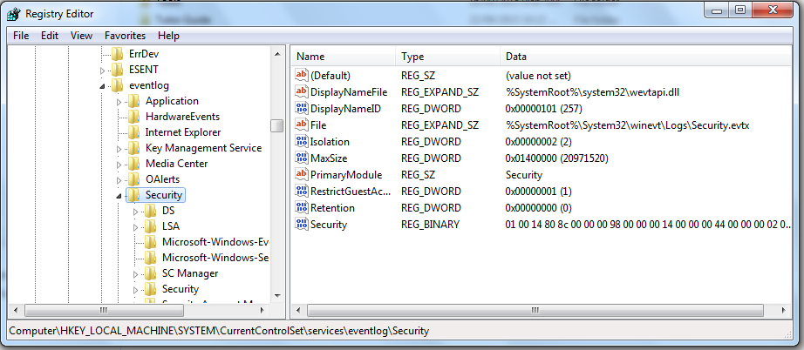
Event Logs – cont.
Security
%SYSTEMROOT%\System32\Winevt\Logs\Security.evtx
Click Start and enter “Regedit” to open up Registry Editor

Slide 43
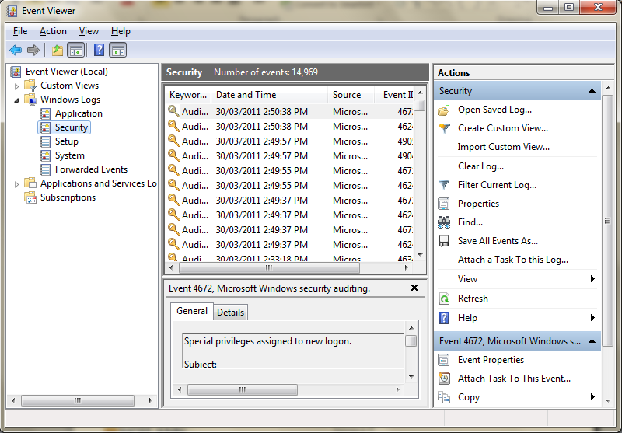
Event Viewer
Click Start > Control Panel > Administrative Tools > Event Viewer

Slide 44
Event IDs
Every type of event tracked in Windows event logs has an associated ID value.
These IDs are often more useful than the event message itself.
Microsoft provides a useful search engine, called Event and Errors Message Center that FI can query:
www.myeventlog.com
www.eventid.net
Note that these websites lack coverage of event IDs from Applications and Services logs.

Slide 45
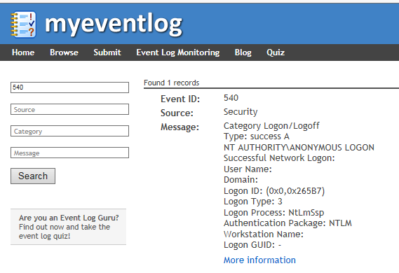
Event ID: 540

Slide 46
Understanding Logon Events
Let’s look an example of a logon event.
Event ID: 540
Successful Network Logon:
User Name: Administrator
Domain: CORPDOMAIN
Logon ID: (0x0, 0x3E2C4E73)
Logon Type: 3
Logon Process: NtLmSsp
Authentication Package: NTLM
Workstation Name: laptop1022
Source Network Address: 10.0.1.13

Slide 47
Understanding Logon Events – cont.
Here’s the definition for each field:
User Name The account used to log on
Domain The domain associated with the user name. If the user is a local account, this field will contain the system’s host name.
Logon ID A unique session identifier. This value can be used to search or filter to find all event log entries associated with this logon session.
Logon Type A code referencing the type of logon initiated by the user.

Slide 48
Understanding Logon Events – cont.
The following table provides details on Logon Type and its possible values:
Type | Code | Brief Descriptions
Interactive | 2 | The user logged on from the console
Network | 3 | The user logged on over the network
Batch | 4 | The logon session generated by a scheduled task
Service | 5 | The Windows service logged on using its configured credentials
Proxy | 6 | Proxy-type logon
Unlock | 7 | The user unlocked the system (e.g. resuming from screensaver)
NetworkCleartext | 8 | Generated by basic authentication logins on web servers.
NewCredentials | 9 | User assumed a different set of credentials for a remote connection
RemoteInteractive | 10 | User logged on via Terminal Services or Remote Desktop
CacheInteractive | 11 | User logged on with domain credentials that were validated using local cache data rather than domain controller

Slide 49
Understanding Logon Events – cont.
The Logon Type field can be a useful data point when searching or filtering the security event log. For example:
If you know an attacker accesses the system using stolen credentials via the “net use” command, you may want to disregard Unlock and Console logons as noise from legitimate system usage.
If an application service account is never supposed to log on interactively, you may want to focus on RemoteInteractive logon events with its credentials.

Slide 50
Understanding Logon Events – cont.
Logon Process The process that initiated the logon event.
Authentication Package The security and authentication protocol used to process the logon event.
Workstation Name The source system from which the logon originated.
Source Network Address The source IP address from which the logon originated.

Slide 51
Summary
Evidence examination includes extraction and analysis of evidence.
We covered 5 types of extraction methods: manual inspection, file Signatures, metadata, string and keyword searching, and file carving.
We covered 3 types of analysis methods: Timeframe, Data hiding, Application and file.
Event logs (Application, System and Security) are commonly used in forensic investigations to gather evidence and find out more about attacker’s intention.

